Slide 1
Introduction to design patterns

Slide 2
Hoanh Tran (hoanh_tran@yahoo.com)
Enterprise Architect UML Model and slides download
https://github.com/h-t-tran/DesignPattern

Slide 3
agenda
Overview
Abstract Factory Pattern
State Pattern
Strategy Pattern
Null Object Pattern

Slide 4
What is design pattern
Formal Definition:
Each pattern describes a problem that occurs over and over again in our environment, and then describes the core of the solution to that problem, in such a way that you can use this solution a million times over, without ever doing it the same way twice. — Christopher Alexander from GoF (Eric Gamma, Richard Helm, Ralph Johnson, John Vlissides) book.
Informal Definition:
A set of heuristics, idioms, guidelines and rules used when designing software.
Formalize communication between SW designers.

Slide 5
Common design pattern references
23 classic design patterns from Gang of Four book.
Discusses the common patterns such as singleton, factory, decorator, state, etc. Focuses at class level.
Pattern Oriented Software Architecture (POSA) (16 patterns)
Discusses higher level patterns such as MVC, Publish-Subscriber, Pipes & Filters, etc. Focuses at component level.
Core J2EE Patterns(21 patterns)
Covers web domain patterns such as Data Access Object (DAO), Data Transfer Object (DTO), Front Controller, etc.

Slide 6
design patterns categories
Creational Patterns - abstract the instantiation process by reducing the number of “new” in the client code.
Structural Patterns – describe how to use inheritance, composition to group classes and interfaces to form larger structures.
Behavior Patterns – describes the communication between objects. It uses inheritance to distribute behavior between classes.

Slide 7
design patterns categories
Creational Patterns:
Singleton – enforces a single point of access to a resource
* Abstract Factory – abstraction to create a families of object without having to know the concrete types.
Factory Method – similar to Abstract Factory, but it is to create a single object.
* Will be covered in detail

Slide 8
design patterns categories
Structural Patterns:
Façade – abstract a complex subsystem from the user by providing a simplified set of APIs.
Decorator – using composition (instead of subclassing) to add new behavior to a class.
Adapter – create a new interface to an existing class that you can’t modified so it can be used by your app.
Proxy – create a placeholder to an existing class with the same interface. Typically used to control access to a remote object.
* Will be covered in detail

Slide 9
design patterns categories
Behavior Patterns:
Command– encapsulate each request as a command object which knows how to carry out its operation.
Iterator – allows client to access a collection of objects sequentially w/out having to knowing the underlying representation.
* State – uses to represent a state machine.
* Strategy – provides a common interface for a group of complex algorithms to a client. We can switch the algorithm without affecting client code.
Template Method – provides a recipe to perform a complex operation, but defer some steps to subclasses.
* Will be covered in detail

Slide 10
Abstract Factory

Slide 11
Abstract Factory
Motivation
Provides an abstraction when creating different families of objects.
Reduces if-then-else or switch statements.
Example
“Home Building” software that supports different types of home (cheap home, tract home, luxury home).
A home has several features such as window, door, floor.
Let’s assume the software has 2 operations build() and print().
3 families (cheap, tract, luxury)
Each family has 3 objects (window, door, floor)

Slide 12
Abstract Factory (cont)
Not-so-elegant implementation
Class HomeBuildingApp
{
void build()
{
switch( homeType)
{
case “cheap”:
var window = new CheapWindow();
var door = new CheapDoor();
var floor = new CheapFloor();
case “luxury”:
var window = new LuxuryWindow();
var door = new LuxuryDoor();
var floor = new LuxuryFloor();
case “tract”:
var window = new TractWindow();
var door = new TractDoor();
var floor = new TractFloor();
/* use the window, door and floor to build the house and display on the screen*/
}
}

Slide 13
Abstract Factory (cont)
void print()
{
switch( homeType)
{
case “cheap”:
var window = new CheapWindow();
var door = new CheapDoor();
var floor = new CheapFloor();
case “luxury”:
var window = new LuxuryWindow();
var door = new LuxuryDoor();
var floor = new LuxuryFloor();
case “tract”:
var window = new TractWindow();
var door = new TractDoor();
var floor = new TractFloor();
/* layout the window, door and floor then print */
}
}

Slide 14
Abstract Factory (cont)
Pitfalls
If we add a new home type (eg custom home), need to add new “case” in two places.
Both build() and print() know about concrete types instead of working with abstraction.

Slide 15
Abstract Factory (cont) – Revise design

Slide 16
Abstract Factory (cont)

Slide 17
Abstract Factory (cont)
Class HomeBuildingApp
{
private HomeWidgetFactory _factory = new
LuxuryHomeWidgetFactory();
void build()
{
var door = _factory.createDoor();
var wnd= _factory.createWindow();
var floor = _factory.createFloor();
/* use the window, door and floor to build the house and display on the screen*/
}
void print()
{
var door = _factory.createDoor();
var wnd= _factory.createWindow();
var floor = _factory.createFloor();
/* create the layout using the door, window and floor, then print*/
}

Slide 18
Abstract Factory (cont)
Improvement design
HomeBuildingApp does not know the concrete type of window, floor and door. It works with abstraction.
A new home type (eg Custom home) can be added without modifying HomeBuildingApp.

Slide 19
State Pattern

Slide 20
State pattern
Motivation
Eliminate huge if/else or switch statement when processing states.
Eliminate monolithic class.
Decouple state logic into it’s own class.
Improve understandability of the class.

Slide 21
State pattern

Slide 22
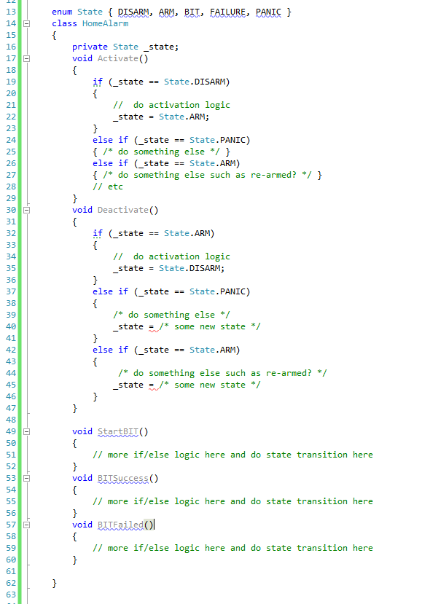
State pattern
Explosion of if/else statement as # of events and state increase.
Difficult to follow logic.

Slide 23
State pattern

Slide 24
State pattern

Slide 25
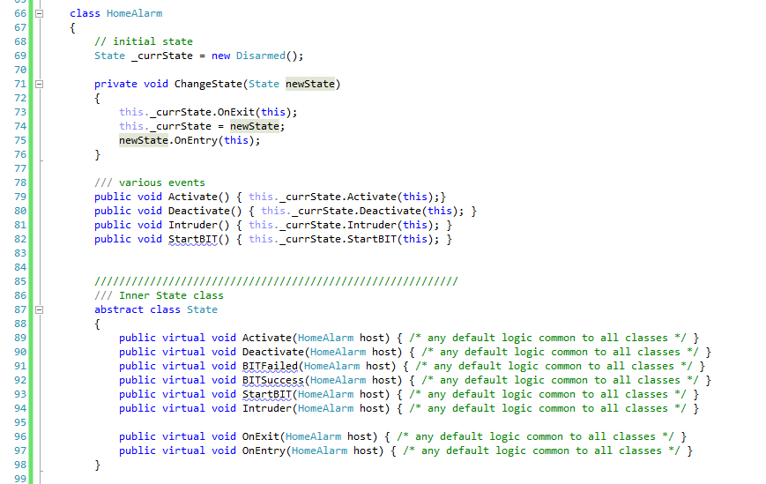
State pattern
Client-facing interface/API.
Client unaware of internal state machine

Slide 26
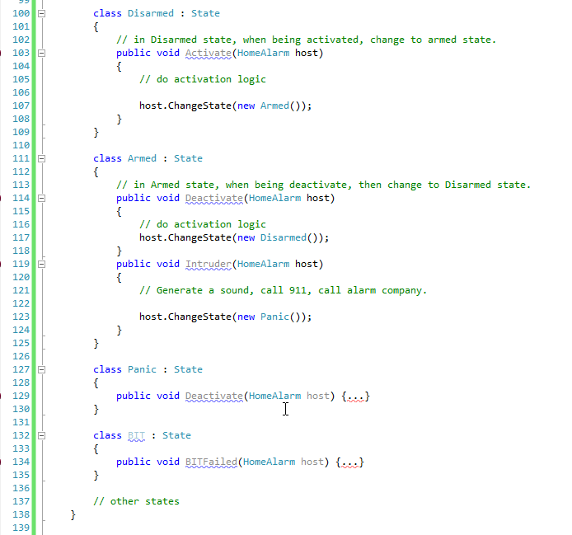
State pattern

Slide 27
Null object Pattern

Slide 28
Null Object Pattern
Motivation
Eliminates the need for NULL check.

Slide 29
Null Object Pattern
This is the “null object” implementation.

Slide 30
Null Object Pattern
Class FTP
{
ICommunicationDevice dev = NULL;
void CreateConnection( ICommunicationDevice dev )
{
this.dev = dev;
}
void OpenSession()
{
if( dev != NULL)
dev.Open();
// other logic that may contain check for dev != NULL
}
void CloseSession()
{
if( dev != NULL)
dev.Close();
// other logic
}
// other method that need to have if(dev != NULL)

Slide 31
Null Object Pattern
Interface ICommunicationDevice
{
void Open() = 0;
void Close() = 0;
void Send() = 0;
void Receive() = 0;
void GetErrorStatus() = 0;
}
// Null Object Implementation as either NOOP or perform some “default” behavior.
Class NullDevice : ICommunicationDevice
{
void Open() { /* no op */ }
void Close() { /* no op */ }
void Send() { /* no op */ }
void Receive() { /* no op */ }
void GetErrorStatus() { /* no op */ }
}

Slide 32
Null Object Pattern
Class FTP
{
ICommunicationDevice dev = new NullDevice(); // ensure dev is always non-null
void CreateConnection( ICommunicationDevice dev )
{
if( dev != null )
this.dev = dev;
}
void OpenSession()
{
if( dev != NULL)
dev.Open();
// we can safely remove all check of dev != NULL
}
void CloseSession()
{
if( dev != NULL)
dev.Close();
// other logic
}

Slide 33
strategy Pattern

Slide 34
Strategy Pattern
Motivation
Allows an object to vary its behavior at runtime using different strategy.
Reduces if/else or switch/case statements.

Slide 35
Strategy Pattern

Slide 36
Strategy Pattern
FTP depends on3 different behaviors - compression, encryption and transmission.
Each behavior has 2 different strategies.
FTP depends only on the interface of each of behavior (ICompression, IEncrypt, ITransmission)
We can inject different strategy of each behavior at runtime.

Slide 37
Strategy Pattern
Not-so-elegant implementation
class FTP {
void SendFile( string filename )
{
if( using AES256)
_encryptor = new AES256Encryptor()
else if(using DES )
_encryptor = new DESEncryptor()
etc.
if( using LZW)
_compressor = new LZWCompressor()
else if(using Looseless)
_compressor = new HomegrownCompressor()
etc.
if( using TCP)
_sender = new TCPTransmission()
else if(using Serial)
_sender = new SerialTransmission()
// Now use _encryptor, _compressor and _sender to encrypt, compress and transmit the file.

Slide 38
Strategy Pattern
Class FTP
{
ICompression _compressor
IEncryptor _encryptor;
ITransmission _sender;
void SendFile()
{
this._encryptor.Encrypt( file )
this._compressor.Compress( file )
this._sender.Transmit ( file )
}
void SetCompressionStrategy (Icompression compress) { this._compressor = compress }
void SetEncryptionStrategy (IEncryption en) { this._encryptor = en}
void SetTransmissionStrategy (ITranmission tr) { this._sender = tr}
…..
}
Injection points of the strategies.

Slide 39
Strategy Pattern
Strategy Pattern is typically used in conjunction with IoC (Inversion of Control) and Dependency Injection.
Separate complex algorithm from the client.

Slide 40
Summary
Briefly discuss some GoF patterns.
Covered 4 popular patterns – Abstract Factory, Null Object, State and Strategy.
Q & A

